Slide 1
Starting with the name of Almighty Allah

Slide 2
SIKANDAR KHAN

Slide 3
Topics
Magnetization
Magnetism
Types of magnetism
Peramagnetism
Ferromagnetism
Diamagnetism

Slide 4
Topic
Magnet and Magnetization

Slide 5
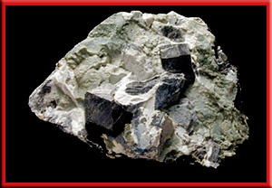
HISTORY:
More than 2,000 years ago Greeks discovered deposits of a mineral that was a natural magnet
The mineral is now
called magnetite

Slide 6
What Is Magnet:
A magnet have a north pole and a south pole
For a bar magnet, the north and south poles are at the opposite ends.
Today, the word magnetism refers to the properties and interactions of magnets

Slide 7
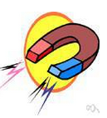
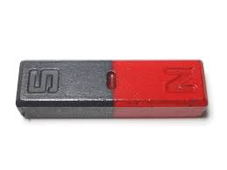
Magnetization
Magnetization the process that makes a substance magnetic (temporarily or permanently).
Or
The extent or degree to which something is magnetized
Or
. The physical property of any object of being magnetic. i.e. attracting the magnetic bodies.

Slide 8
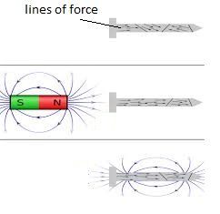
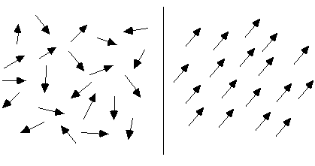
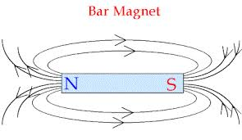
An object when bring in a strong magnetic field it is magnetized:

Slide 9
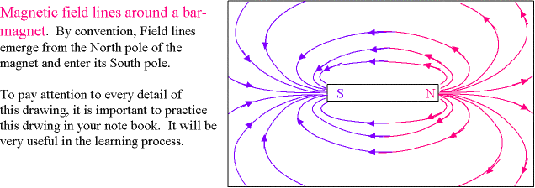
We can make magnets by magnetization (Either permanent or temporary)

Slide 10
Mathematical form:
Magnetization can be defined according to the following equation: M= (N/V) m
Here
M= magnetization;
m= vector that defines the magnetic moment
V =volume
N = number of magnetic moments(m) in the sample.
The quantity N/V is usually written as n, the number density of magnetic moments.
The M is measured in amperes per meter (A/m) in SI units.

Slide 11
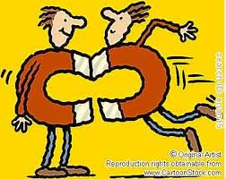
Magnetism
A physical phenomenon produced by the motion of electric charge, which results in attractive and repulsive forces between objects
Notes:
T = u * b

Slide 12
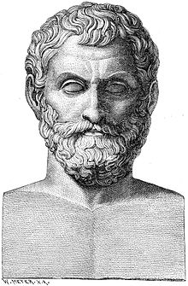
History of mangnetism
Aristotle was the first scientific who did scientific discussion on magnetism who lived from about 525 BC to about 645 BC…..
Around the same time, in ancient India, the Indian surgeon, Sushruta, was the first to make use of the magnet for surgical purposes.^{[2]}

Slide 13
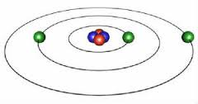
Explanation
Magnetism arises from two types of motions of electrons in atoms
1) one is the motion of the electrons in an orbit around the nucleus

Slide 14
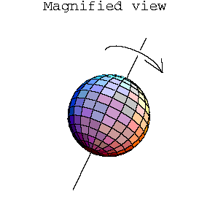
2) other is due to the spin of the
electrons around its axis.
The orbital and the spin motion independently impart a magnetic moment on each electron causing each of them to behave as a tiny magnet.

Slide 15
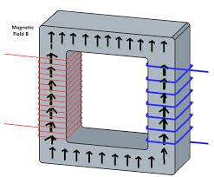
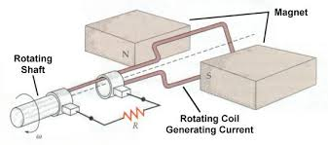
Applications
It is utilized in key components of transformers, in motors and generators.

Slide 16
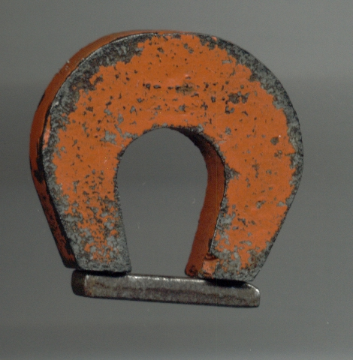
High field superconducting magnets that are now used extensively in hospitals and medical centers for MRI
Magnetic materials that are difficult to demagnetize are used to construct permanent magnets

Slide 17
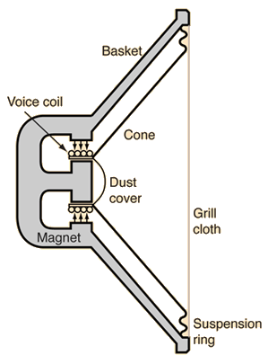
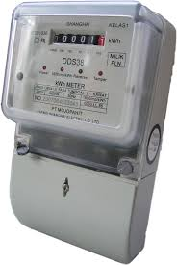
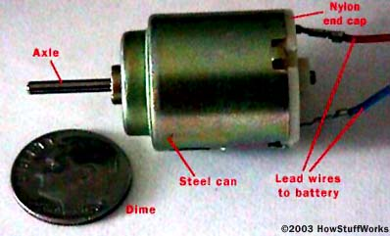
APPLICATIONS:
in loudspeakers, earphones, electric meters, and small motors.

Slide 18
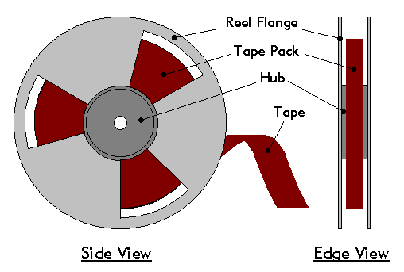

Applications
The more esoteric applications of magnetism are ,magnetic recording and storage devices in computers, and in audio and video systems.

Slide 19
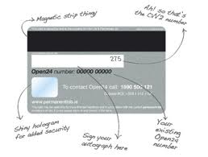
Applications
magnetic strip on the back of debit and credit cards works on the principle of magnetism.

Slide 20
Types of magnetism.
Diamagnetism
Peramagnetism
Ferromagnetism

Slide 21
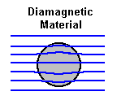
Definition of Diamagnetism.
Diamagnetism is the property of an object which causes it to create a magnetic field in opposition to an externally applied magnetic field and get its self weakly magnetized, thus causing a repulsive effect.

Slide 22
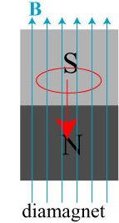
Mechanism
When such materials placed in external magnetic field their magnetic domains get aligned in the direction opposite of external field.

Slide 23
Diamagnetic materials
Semiconductors , bismuth, antimony, copper, gold, quartz, mercury, water, alcohol, air, hydrogen etc ..

Slide 24

Definition of ferromagnetism.
Ferromagnetism is the basic mechanism by which certain materials are made permanent magnets, by applying external magnetic field , or , are attracted to magnets.
a magnet formed by Alnico
(iron alloy)

Slide 25
Ferromagnetism
Alnico in addition to iron are composed primarily of aluminium (Al), nickel (Ni) and cobalt and copper.
It possesses a property called coercivity that means resistance to loss of magnetism.

Slide 26
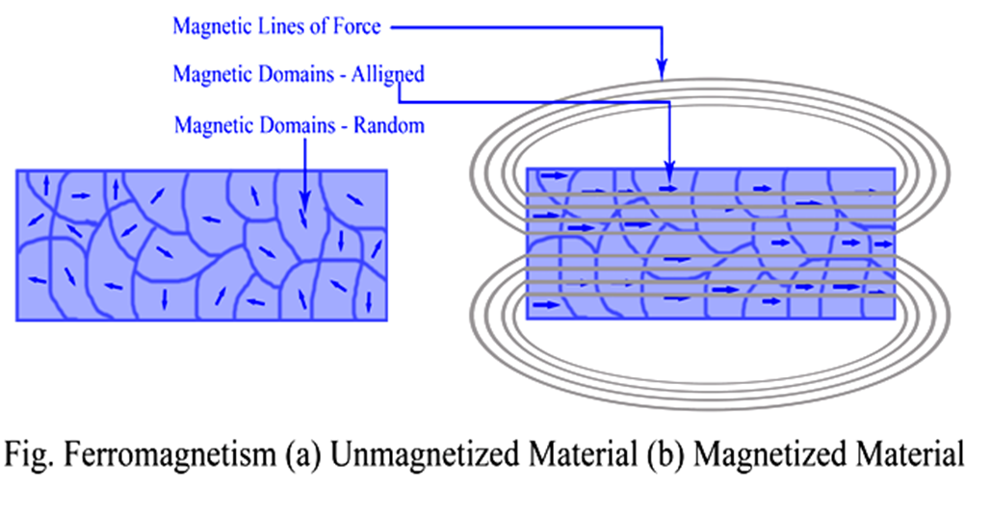

Ferromagnetism
Such materials are capable to retain their magnetic properties even when the magnetic field is removed.

Slide 27
Ferromagnetism
tendency of ferromagnetic material to "remember their magnetic history" is called hysteresis.
the magnetization left behind in a ferromagnetic material (such as iron) after an external magnetic field is removed is called remanent magnetization

Slide 28
Ferromagnetic material.
Materials which show phenomenon of ferromagnetism are called ferromagnetic materials , like
iron, nickel, cobalt, their alloys, and some alloys of rare earth metals.

Slide 29
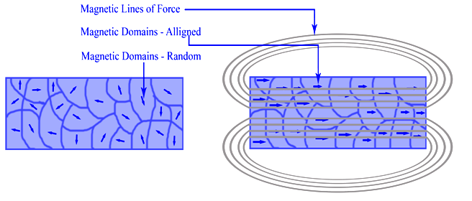
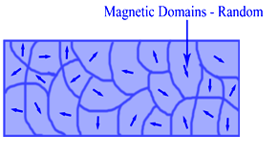
Definition of paramagnetism
a phenomenon in which certain materials become magnetized when placed in magnetic field but their magnetism disappears when the field is removed.

Slide 30
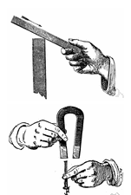
Paramagnetism
They are temporary magnets.

Slide 31
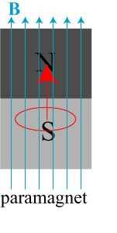
Mechanism
When such materials placed in external magnetic field their magnetic domains get aligned in the direction opposite of external field.
External magnetic field
Notes:
External magnetic field

Slide 32
Paramagnetic material
Oxygen
platinum
aluminum
tungsten
cesium

